Slide 1

Data Structures and Algorithms Odd Semester 2021
3rd Semester , Computer Science and Engineering
Jaypee Institute Of Information Technology (JIIT), Noida

Slide 2
Lecture: 13-15
Topics to be covered:
Hashing concept
Hash Table
Hash Function
Collision Resolution Techniques
Hashing Applications

Slide 3
Hashing
In linear and binary search, we need to perform several operations to locate a particular target data. The operations are computation of search index, comparison of target with the data at that index and modifying the index in case target is not found.
In ideal case, we expect to search the target in or fewer steps. One way to achieve this is we should obtain the address where the data is stored.
Hashing is a technique to find the address where the data is located with the help of a key by using mathematical function called hash function.
The process of mapping key to address is called as hashing.

Slide 4
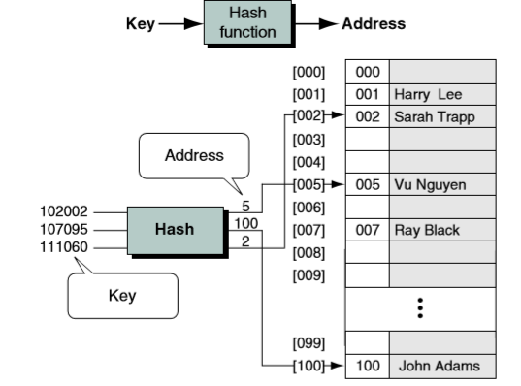
Hashing Concept
Source: Gilberg, Richard F., and Behrouz A. Forouzan. Data Structures: A pseudocode approach with C. Nelson Education, 2004.

Slide 5
Components of Hashing
There are four key components of hashing:
Hash Table
Hash Functions
Collisions
Collision Resolution Techniques

Slide 6
Hash Table
Hash table is a data structure which stores keys and their associated values and it uses hash function for mapping keys with their associated values.
Hash table is an array [0 to M-1] having size M.
Insertion, deletion and search operations in hashing can be performed with constant time complexity (i.e. O(1)).

Slide 7
Direct Addressing
Using an array, the element with key k is stored at a position k of the array. That means, given a key k, we find the element whose key is k by just looking in the kth position of the array. This is called direct addressing.
Key values are assumed to be unique.
Each key is taken from universe U = {0, 1, . . . , n - 1}
Direct Address Table is represented as an array T[0 . . . n - 1]

Slide 8
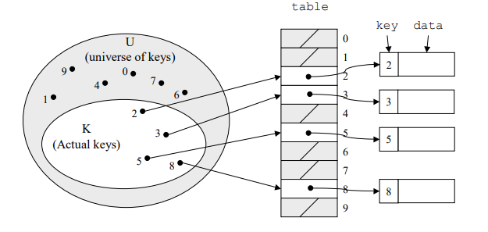
Direct Addressing
Source: Cormen, Thomas H., et al. Introduction to algorithms. MIT press, 2009.

Slide 9
Hash Table
The problem with Direct addressing is that if the universe U is large, then to store a table T of size |U| is not possible, considering the limited memory available on a computer.
In this case one approach is to use hash tables.
With direct addressing, an element with key k is stored in slot k. With hashing, this element will be stored in the slot h(k) i.e. we use a hash function h to map keys to their associated values.

Slide 10
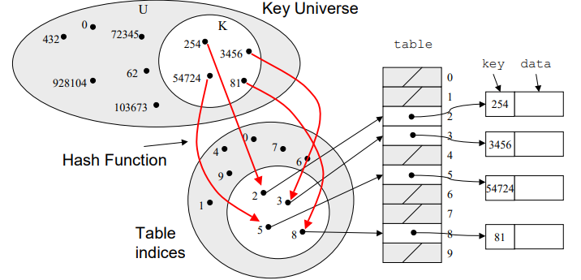
Mapping Keys
Source: Cormen, Thomas H., et al. Introduction to algorithms. MIT press, 2009.

Slide 11
Hash Function
The hash function is used to map the key into the index of hash table.
Given a set of elements, a hash function which maps each item into a unique slot is known as a perfect hash function.
Given a set of elements, unfortunately there is no systematic way to build a perfect hash function.
Our goal is to create a hash function that minimizes the no. of collisions, which is easy to compute, and evenly distributes the elements in the hash table.

Slide 12
Features of a good Hash Function
Addresses (or index values) generated from the key are distributed uniformly and randomly.
If there is small variation in key values then it will cause large variation in indexes so that they are distributed evenly.
The hash function should minimize the collisions.

Slide 13
Some Hash Function Methods
There are many methods to implement hash functions:
Division Method
Hash Function: Hash(Key)= Key % M
where M is hash table size
Key is divided by M, and the remainder is used as the hash address.
The most appropriate hash table size is prime numbers.

Slide 14
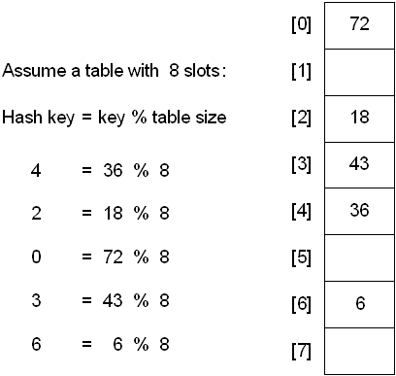
Example
Source: http://faculty.cs.niu.edu/~freedman/340/340notes/340hash.htm

Slide 15
Some Hash Function Methods
Mid-square Hashing
Take the square of key and take middle digits of squared key as address.
Eg. Key= 2341 Square= 5480281 Hashed Address= 802
The problem is when key is large. It will be difficult to store the squared value.
So, this method is used when key size is <= 4 digits.

Slide 16
Some Hash Function Methods
Folding Method
In this method, key is divided into subparts of equal length (besides the last part) which are combined or folded to form a new address.
Fold Shift: Key value is divided into various parts of the size of address. Then add those parts.
Fold Boundary: Key value is divided into various parts of the size of address. Then parts are added on fixed boundary.
Eg: Key is 876743
For fold shift, the sum is 87+67+43= 197
Discard 1 , address is 97
For fold boundary, the sum is 78+76+34= 188
Discard 1 , address is 88

Slide 17
Some Terms
Load Factor: It is the no. of elements in hash table divided by size of the table.
Probe: Each action of address calculation and checking for success.
Collision: The two or more keys hashing to the same address is known as collisions.

Slide 18
Collision Resolution Techniques
The process of finding the alternate location is known as collision resolution.
There are many collision resolution methods:
Direct Chaining: Linked list implementation
Separate chaining
Open Addressing: Array-based implementation
Linear probing (linear search)
Quadratic probing (nonlinear search)
Double hashing (use two hash functions)

Slide 19
Separate Chaining
Collision resolution by separate chaining combines linked representation with hash table.
When two or more records are hashed to the same location, these records are inserted into a singly-linked list called a chain.
However, pointers are needed to handle to form a chain. The extra memory is required to store pointers.
More items can be stored than the size of hash table.
The hash table slot will not hold the key element. They will now store the address of a key element.

Slide 20
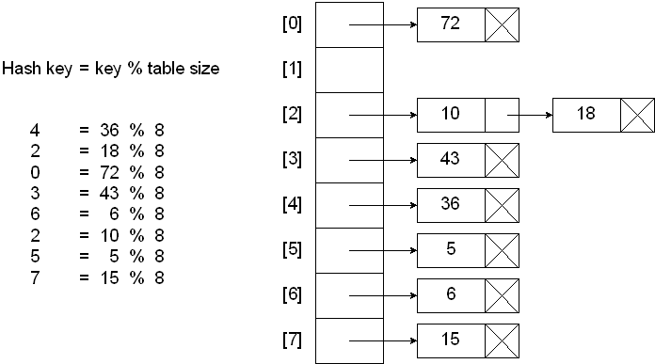
Separate Chaining
Source: http://faculty.cs.niu.edu/~freedman/340/340notes/340hash.htm

Slide 21
Separate Chaining
When a new element is hashed to same address, it can be inserted either at the front or at the end of the list.
New elements are sometimes inserted at the front of the list, since it may be convenient and it happens frequently that the recently inserted elements are more probably to be accessed in near future.
Average length of linked list= X/Y, where X is size of array, Y is no. of linked list.
Analysis of Chaining:
If Y is too large, then there can be too many empty chains
If Y is too small, then chains can be too long.

Slide 22
Open addressing
Separate chaining has the disadvantage of requiring pointers. This tends to slow down the algorithm a bit because time is required to allocate new cells, and also it requires the implementation of second data structure.
Open addressing is also known as closed hashing.
In open addressing method, all the keys are stored in the hash table itself.
A collision is resolved by probing.
If a collision occurs, then hash table is examined or probed until an available empty slot is found.

Slide 23
Open Addressing
With open addressing, for every key k, the probe sequence is h(k)+C(0),h(k)+C(1),……..h(k)+C(i)
where h(k) is the hashing function, C(i) is the probing function with i^{th} probe.
The probe sequence depend on the key to be inserted.
The three common collision resolution techniques:
Linear Probing
Quadratic probing
Double hashing

Slide 24
Linear Probing
In linear probing, the collision is resolved by storing the element in the next empty slot.
It is implemented by using linear search for an empty slot.
When we reach the end of table, the search is wrapped around to start.
The function used for linear probing is as follows:
(H(k)+p(i)) MOD M
As p(i)=i for linear probing, the function becomes
(H(k)+i) MOD M
where H(k)=k MOD M, M is table size, i={0,1,2,… M-1}

Slide 25
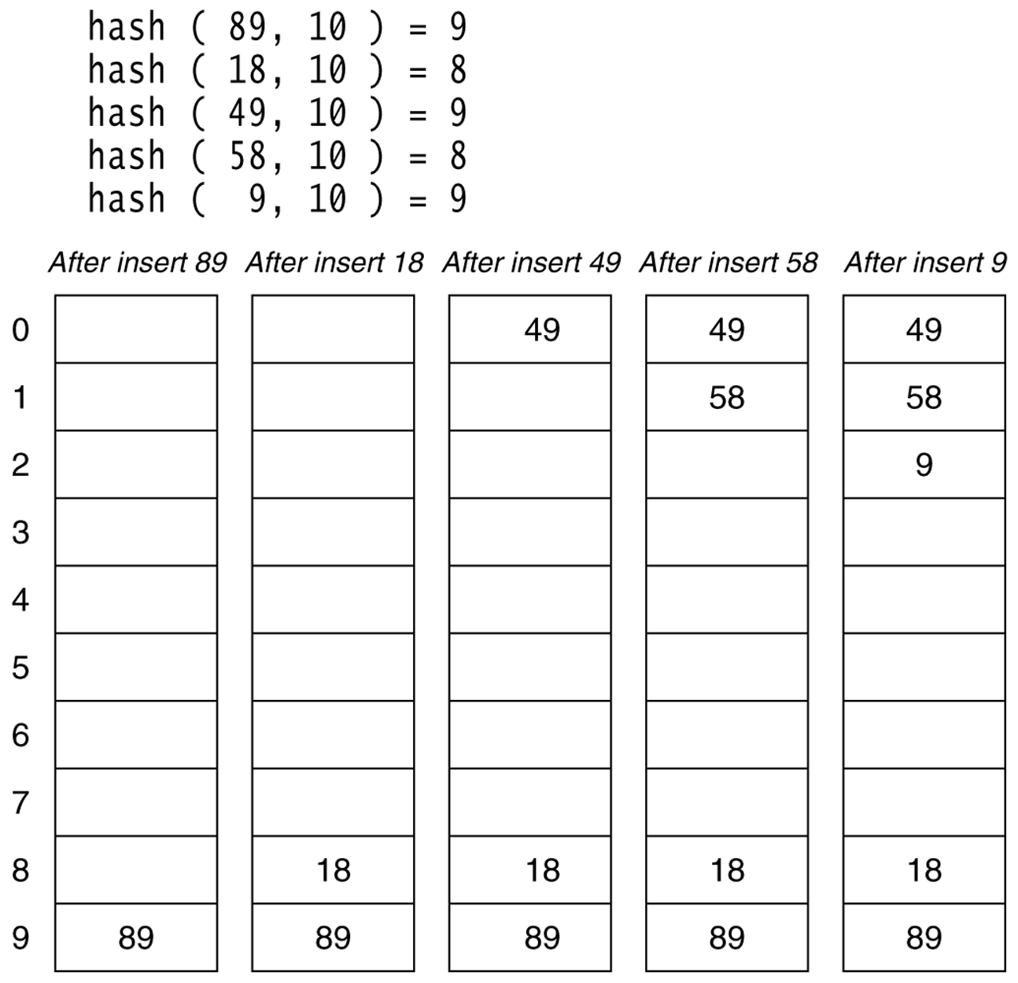
Example
Source: Weiss, Mark Allen. "Data Structures And Problem Solving Using C+."

Slide 26
Linear Probing
The search algorithm follows the same probe sequence as insert algorithm.
If an empty slot is reached then, the item is not found
Otherwise, the match is found.
Example,
We have to search 58 then we will start at slot 8. The item at slot 8 is not 58, so we will try slot 9. Again, 58 is not at slot 9 , so we will try at slot 0 and then slot 1 until we the item is found. (4 probes)
Now, we have to search 19, we will try slots 9, 0, 1, and 2 before the empty slot is reached at 3. Thus 19 is not found. (5 probes)

Slide 27
Linear Probing
Standard deletion can’t be performed here because, an element in the hash table not only represents itself, but it also serves as a placeholder and connects other elements during collision resolution.
Suppose, if we want to delete 89 from the table, then all the remaining search operations might fail.
Lazy deletion is implemented. That means elements are marked as deleted rather than removing them physically from the hash table. This information can be stored as an extra data member. Each element can be either active or deleted.

Slide 28
Linear Probing
One of the problems with linear probing is that elements tend to cluster together in the hash table. It means that the table contains blocks of consecutively occupied cells that is called primary clustering.
Clusters can get close to each other, and can form a larger cluster. Therefore, one part in the table might be quite dense, and another part might be having relatively few items.
Any key which is hashed into cluster will require excessive attempts for collision resolution causing long probe searches therefore results in poor overall efficiency.

Slide 29
Quadratic Probing
The primary clustering can be eliminated by using Quadratic Probing method by examining certain slots away from the original probed position.
Here, Collision Function is F(i)=i² is quadratic.
That means subsequent probes are quadratic no. of positions away from original probe point.
If we are searching for key k, then we will check H(k), H(k)+ 1², H(k)+2²…. H(k)+i² (wraparound) until k is found or an empty slot is found.
The function used for quadratic probing is as follows:
(H(k)+i²) MOD M
where H(k)=k MOD M, M is table size

Slide 30
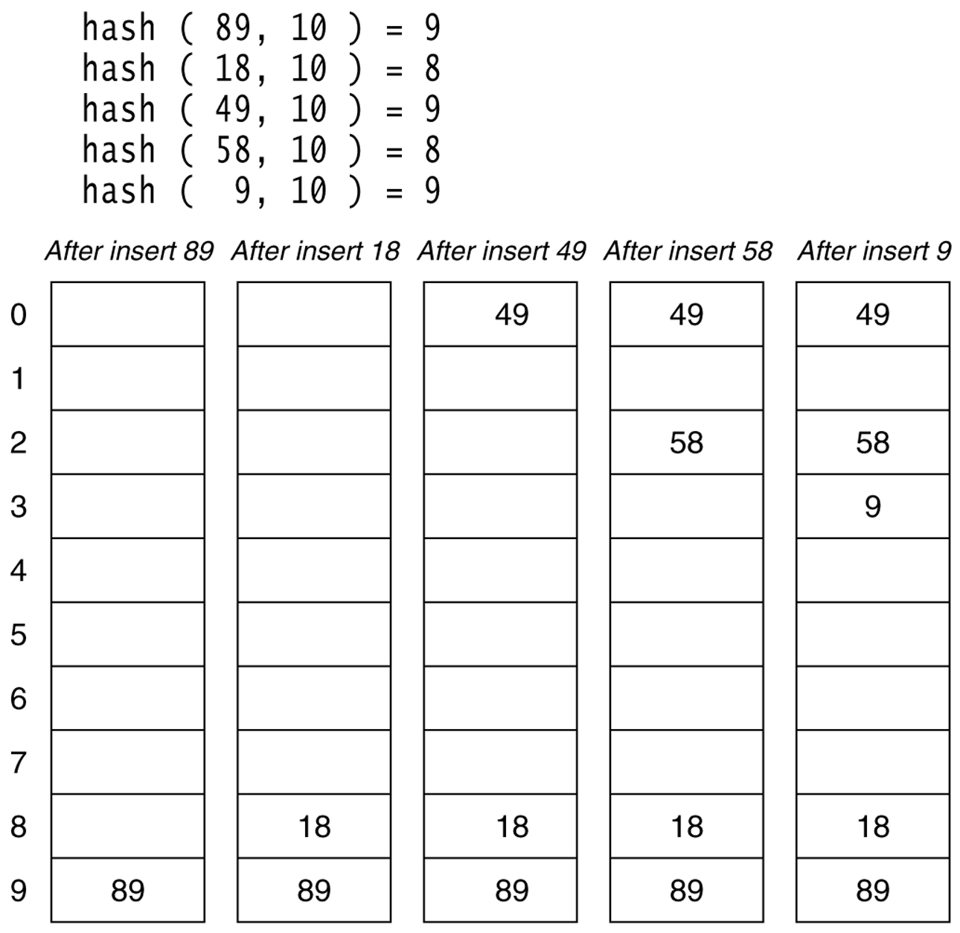
Example
Source: Weiss, Mark Allen. "Data Structures And Problem Solving Using C+."

Slide 31
Quadratic Probing
Does quadratic probing guarantee that if we are inserting K and the hash table is not full, will K be inserted?
If the hash table size is prime no. and load factor doesn’t exceeds 0.5, then we have a guarantee that there is success in insertion of a new item K.
But even if the table size is one more than half full then insertion could fail.

Slide 32
Analysis of Quadratic Probing
In quadratic probing, items which hash to the same address will follow the same path or alternative cells, which is called as secondary clustering.
Technique which can remove secondary clustering is double hashing.

Slide 33
Double Hashing
When a collision occurs, we apply a second hash function in double hashing.
The function used for double hashing is as follows:
H(k,i)= (H1(k) + i H2(k) ) mod M
where , M is table size and i=0,1,...
The size of hash table should be a prime number.

Slide 34
Example
Given, Table size=11, h1(k) = k Mod 11, h2(key) = 7- (k mod 7)
Insert following keys: 47, 14, 91, 25
H(k,i) = (H₁(k) + i H₂(k) ) mod 11
H(47,0)= 47 mod 11 = 3
H(14,0)=14 mod 11 = 3
H(14,1)= (3 + 7- (14 mod 7)) mod 11 = 10
H(91,0)= 91 mod 11 = 3
H(91,1)= (3 +7 –(91 mod 7)) mod 11 =10
H(91,2)= 3+ 2* 7 mod 11 = 6
H(25,0)= 25 mod 11 = 3
H(25,1)=(3 + 7- (25 mod 7)) mod 11=6
H(25,2)= (3 + 2 * 7- (25 mod 7)) mod 11= 9
0
47
91
25
14
1
2
3
4
5
6
7
8
9
10

Slide 35
Double Hashing
When table size is prime or power of 2, it improves over linear or quadratic probing as max m² probe sequences are used in double hashing, rather than m, since each h1(k),h2(k) pair yields a different probe sequence.
However, double hashing is somewhat more complicated to implement than quadratic probing.

Slide 36
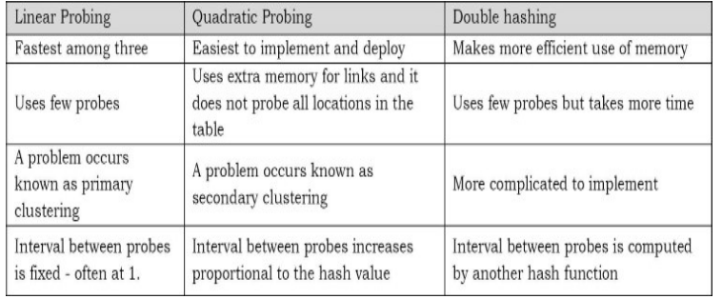
Comparison of Open Addressing Methods
Source: Karumanchi, Narasimha. Data Structures and Algorithms Made Easy

Slide 37
Hashing Applications
Hash tables are used by compilers to keep track of variables declared in source code. The data structure is known as symbol table.
Another application is game programs. As the program look through different lines of play, it monitors positions that it has experienced by computing a hash function on the basis of position
Hashing is also used in online spelling checkers.

Slide 38
Exercise
Consider the keys {2451, 8253, 6173, 7389, 4344, 9699, 1889} and H(k)=k Mod 10. Show the Hash table for the following:
1. Open Addressing using linear probing.
2. Open Addressing using quadratic probing.
3. Open Addressing using double hashing, h2(k)=7- (k mod 7).

Slide 39
Solution
 | Linear probing | Quadratic Probing | Double Hashing
0 | 9699 | 9699 | 1889
1 | 2451 | 2451 | 2451
2 | 1889 |  | 9699
3 | 8253 | 8253 | 8253
4 | 6173 | 6173 | 6173
5 | 4344 | 4344
6
7 |  |  | 4344
8 |  | 1889
9 | 7389 | 7389 | 7389

Slide 40
References
Cormen, Thomas H., et al. Introduction to algorithms. MIT press, 2009.
Karumanchi, Narasimha. Data Structures and Algorithms Made Easy
Weiss, Mark Allen. "Data Structures And Problem Solving Using C+."

